Slide 1
ASSESSMENT ON KNOWLEDGE, ATTITUDES AND PRACTICES
ON DOG BITES IN KYEGEGWA TOWN COUNCIL,
KYEGEGWA DISRICTICT
APRIL – JUNE. 2024
David Ainebyona
ISAVET Cohort 5
Mentor: Dr. Musiime Edgar
Trainer: Dr. Hannington Katumba

Slide 2
Background
Dog bites are most important source of rabies virus infection to humans, livestock and wildlife (Kankya et al., 2022), With 99% of human infection being from Dog rabies that pose a threat to 3.3 billion people worldwide (Knobel et at., 2005)
Rabies is a major zoonotic disease threatening Global public health, and rabies virus is transmitted to humans through a bite (Organization, 2018, 2019b)

Slide 3
contind…..
Rabies is caused by Rabies Virus of family Rhabdoviridae(Masiira et al., 2018) and virus is transmitted to humans through a bite and of all human cases, up to 99% are acquired from the bite of an infected dog (Organization, 2019a)
Causing 55000 human death annually with Asia and Africa being worst affected (Monje et at., 2020), In Uganda 486 human rabies death occur every year with 13900 Dog bites registered from 2001 to 2015(Kisaka et al., 2020; Kankya et al., 2022)
USD 8.6 billion in economic losses worldwide annually( Shantavasinkul and wilde, 2011)

Slide 4
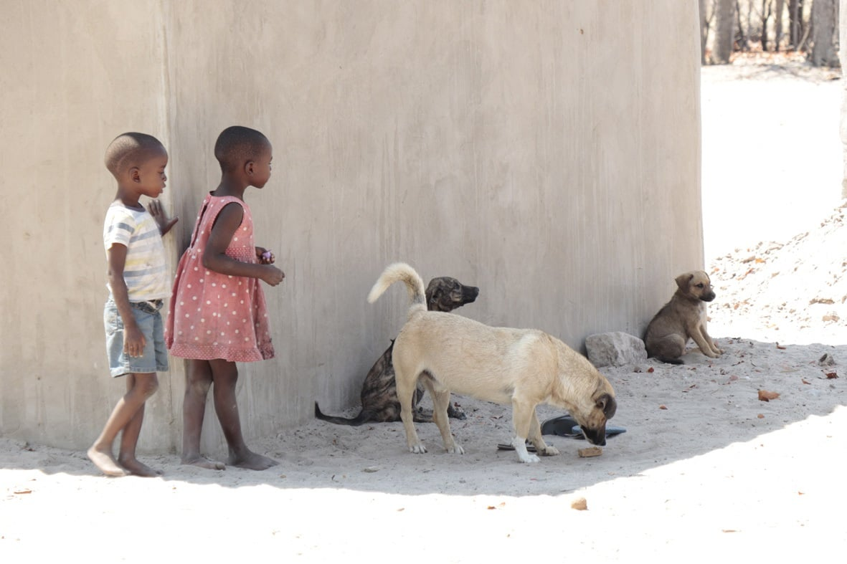
Problem statement
Dog bites is the major source of rabies in human and livestock and poses a high threat to Children(<15 years), (Organization, 2018, 2019b; Kisaka et al., 2020)
There was poor reporting of the rabies data which was attributed to population knowledge, attitudes and practices(Makerere University on Rabies in Kyegegwa district march 2023, SVO and DHO) and this called for study of knowledge, attitudes and practices on dog bites in kyegegwa town council, kyegegwa district
Credit: Friedrich, Loeffler Institute(FLI)Namibia

Slide 5
Justification
Kyegegwa district will be in position to make informed decision about Dog bites in regard of an opinion on dog population and awareness campaigns about Dog –mediated rabies.
The district will use the study data to bridge the gap between dog- bite mediated rabies in the populations

Slide 6
Objectives
General Objective
To assessment on knowledge, attitudes and practices on dog bites and its management in of Kyegegwa Town Council, Kyegegwa district
Specific Objectives
To ascertain knowledge, attitudes related to dog bites.
To study the first aid measures used by the population after dog bites
Notes:
The study specific to understand the knowledge and seeking practices used by the people in kyegegwa town council. There are many stray dogs in the town council that result into increasing cases of dog bites( District veterinary officer and District Health officer)

Slide 7
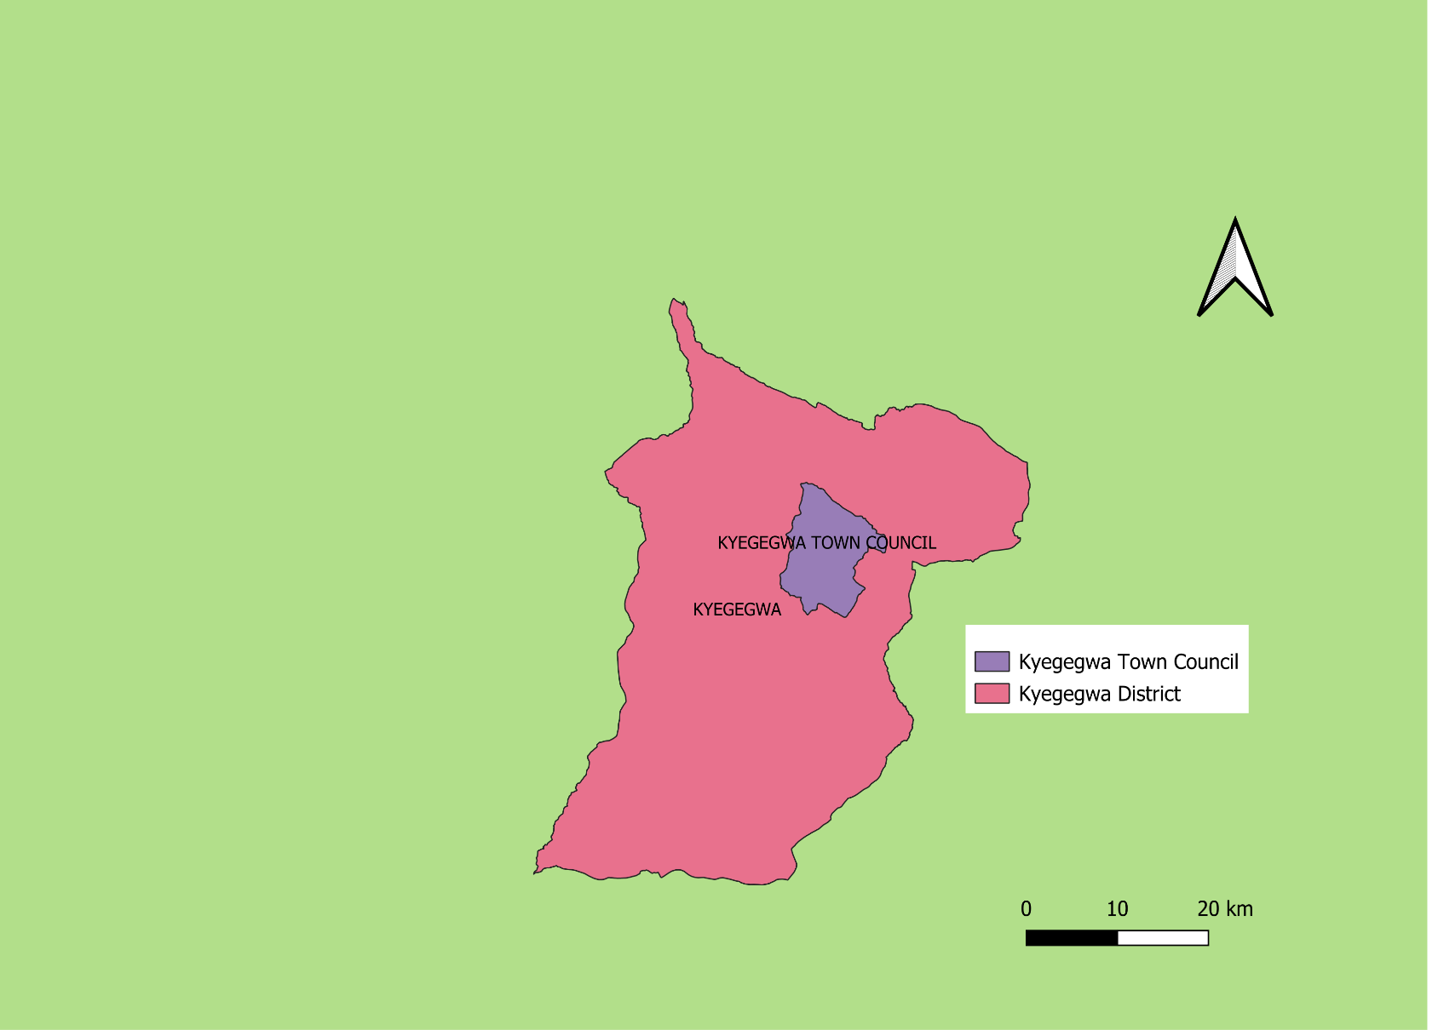
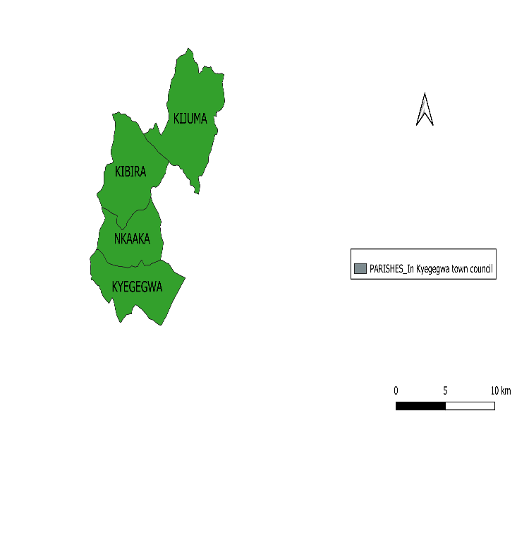
Map of Kyegegwa District showing kyegegwa Town Council Study Area

Slide 8
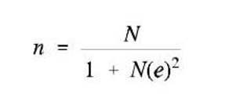
Methods
Community based cross-sectional study on dog bites and its management was conducted in 4 wards of Kyegegwa Town Council, Kyegegwa District
A Semi-structured Questionnaire- Using Random sampling of participant in different wards parts of Kyegegwa Town councils
Yamane Formula was determine the sample size taking 95% confidence level, Where; n is the sample size
N, is the population
e, is an acceptable margin of error.

Slide 9
contind…
A total no of 206 respondents were surveyed using a pre – designed and pretested semi-structured questionnaire with sections of socio-demographics, Knowledge, attitude and practices regarding Dog bites and its management
After explanation the purpose of the study, a verbal consent was obtained from each respondent before start of the interview
For confidentiality purpose, all the questionnaire we recorded and kept under lock

Slide 10
contind…
Any one adult member of the family preferably the head of the household was included as a study respondent
Selected households, priority was given to those with Dogs
Data was collected by one by one method entered in excel and analyzed
All qualitative variables were calculated for proportions to look for association in the KAP regarding dog bites and a p value <0.05 was considered significant

Slide 11
A pie chart showing Demographics according to Age and sex

Slide 12
contind….
Table 2: Knowledge regarding cause, spread mortality, morbidity related to rabies among respondents (N=206)
.
Variables | Frequency (%)
Causes of rabies
Animals | 151(73.7)
Microorganism | 14(6.8)
Don’t know | 40(19.5)
Mosquito | 0(0)
Spread of rabies
Rats | 0(0)
cats | 1(0.5)
Dog | 168(82)
Fox | 16(7.8)
Others | 0(0)
Don’t know | 20(9.8)
Can rabies cause death
Yes | 189(91.7)
No | 3(1.5)
Don’t know | 14(6.8)
is there vaccine for rabies (Human/Pets)
Yes | 33(16.1)
No | 9(4.4)
Don’t know | 163(79.5)
Received any training or information on rabies
Yes | 26(12.7)
No | 179(87.3)

Slide 13
Pie charts showing knowledge on post bite management
.

Slide 14
contind...
Table 3: Attitudes regarding health seeking, and dog vaccination among the respondents (N=206).
Variables | Frequency (%)
Should dogs be vaccinated
Yes | 194(92.2)
Not sure | 11(5.3)
No | 1(0.5)
Is it essential to get or give first aid after dog bite
Yes | 193(93.7)
No | 4(1.9)
Not sure | 9(4.4)
Is it essential to take treatment after a dog bite
Yes | 182(88.3)
No | 2(1)
Not sure | 22(10.7)
After how long should someone seek treatment after a dog bite
Immediately | 161(78.2)
Few hours | 30(14.6)
1 day | 8(3.9)
Few days | 0(0)
Don’t know | 7(3.4)

Slide 15
Pie charts showing attitude of post bite management among respondents
.

Slide 16
contind….
Table 4:Practices regarding prevention of rabies among the study respondents (N=206)
Variables | Frequency (%)
Measures take at home after Dog bite
wash with soap and clean water | 95(46.1)
Native treatment | 28(13.5)
Antiseptic bandaging | 3(1.5)
Tightly tie above above the site of bite | 79(38.3)
Take rabies vaccine | 0(0)
Others | 1(0.5)
Do nothing | 0(0)
How do you handle rabid dog
Poisoning | 88(42.7)
Shooting | 0(0)
Beating | 110(53.4)
Do nothing | 0(0)
Don’t know | 8(3.9)
Methods of disposal of suspected dead rabid dog
Deep burial | 173(84)
Burning | 12(5.8)
Open field disposal | 21(10.2)
Don’t know | 0(0)
Place to get treatment in case of dog bite
General Hospital | 133(64.6)
Local Clinic | 35(17)
Local drug shop | 8(3.9)
No where | 0(0)
Not sure | 0(0)
Native treatment | 30(14.6)

Slide 17
A graph showing the measures taken at home after dog bite
.

Slide 18
Discussions
In community based study considering the knowledge regarding cause, 14(6.8%) of respondents knew the cause of rabies as microorganism and 151(73.7 %) thought it was caused by animals and this was found similar to a study done by (Joice et al., 2016), 163(79.5%) were not aware of the presence of vaccine for rabies after dog bite both in humans and Animals in contrast to study done by (Kisaka et al., 2020), 179 (87.3) % of the respondents have not received and training about rabies in contrast to the study by (Joice et al., 2016)
In study, 161(78.2%) of the respondents would seek treatment immediately 30(14.6%) take few hours 8(3.9 %) take 1 day and unfortunately 7(3.4 %) don’t know how long should someone seek treatment after a dog bite

Slide 19
Contind….
Considering the practices after dog bite 95(46.1%) of respondents wash their hands with water and soap after dog bite which was found similar to (Joice et al., 2016) 79(38.3) tightly tie above the site of Bite 28(13.5) use native treatment and sadly, 0 (0%) take rabies vaccine after dog bites at home
Of 173(84) dispose off suspected dead rabid dog by deep burial 12(5.8) do burning and 21(10.2%) do open field disposal which is contaminates the environment.
Regarding ways to handle suspected rabid dog 88(42.7%) use poisoning110(53.4%) beating which is unsafe and 8(3.9%) unfortunately don’t know the better way to handle a rabid dog

Slide 20
Conclusions
There was good knowledge with respect to mode of spread, mortality and morbidity however the knowledge regarding the cause of rabies 151(73.7%-don’t know), presence 163(79.5% don’t know ) and use 206(0% don’t use ) of anti-rabies vaccine for both humans and animals was poor in relation to management after dog bites and unfortunately 179(87.3%) of the respondents have not received any training on dog bite –mediated rabies
The practices of study respondents with regard to prevention and treatment showed that most were willing for deep burial of dead suspected rabid dogs, but with unsafe and welfare contradicting method of handling suspected rabid dog. Also most of respondents were open to report health facility after a dog bite however some 30(14.6%)
resort to native treatment following a dog bite

Slide 21
Recommendations
The town council and district should organize an awareness campaigns on the dog-bites, vaccines and vaccination services
The town council and district should establish a data base for dog bite- mediated rabies cases to increase adherence to proper management. The ideology may be borrowed from the e-Rabies react program
The district should establish and functionalize a One Health structure to amplify dog bites cases management across all district concerned department(Health, Veterinary, security and Community leaders)

Slide 22
Acknowledgments
I acknowledge the support through the course by Dr. Chrisostom Ayebazibwe (FAO, Uganda), Dr. Anne Praise Namboowa( MAAIF), Dr. Edgar Musime ( DVO Lyantonde), Dr. Hannington Katumba(KCCA),Dr. Immaculate Akusekera ( Kibaale) and Dr. AnnaMarry Kahunde (VO- Kyegegwa District)
U-YOGA UGANDA
MAAIF
FAO
USAID
Trainers and Trainees

Slide 23
References
Monje, F., Erume, J., Mwiine, F.N., Kazoora, H., Okech, S.G., 2020. Knowledge, attitude and practices about rabies management among human and animal health professionals in Mbale District, Uganda. One Health Outlook 2, 24 https://doi.org/10.1186/s42522-020-00031-6
Shantavasinkul, P., Wilde, H., 2011. Chapter 13 - Post exposure Prophylaxis for Rabies in Resource-Limited/Poor Countries, in: Jackson, A.C. (Ed.), Advances in Virus Research, Research Advances in Rabies. Academic Press, pp. 291–307 https://doi.org/10.1016/B978-0-12-387040-7.00013-5
Kisaka, S., Makumbi, F.E., Majalija, S., Bangirana, A., Thumbi, S.M., 2020. Epidemiology and preclinical management of dog bites among humans in Wakiso and Kampala districts, Uganda: Implications for prevention of dog bites and rabies. Plos One 15, e0239090.

Slide 24
References Contind….
Kankya, C., Dürr, S., Hartnack, S., Warembourg, C., Okello, J., Muleme, J., Okello, W., Methodius, T., Alobo, G., Odoch, T., 2022. Awareness, Knowledge, and Perceptions Regarding Rabies Prevention Among Rural Communities in Masaka District, Central Uganda: A Qualitative Study. Front. Vet. Sci. 9 https://doi.org/10.3389/fvets.2022.863526
Makerere University on Rabies in Kyegegwa District March 2023
Masiira, B., Makumbi, I., Matovu, J.K.B., Ario, A.R., Nabukenya, I., Kihembo, C., Kaharuza, F., Musenero, M., Mbonye, A., 2018. Long term trends and spatial distribution of animal bite injuries and deaths due to human rabies infection in Uganda, 2001-2015. PLOS ONE 13, e0198568. https://doi.org/10.1371/journal.pone.0198568

